Slide 1

AfterLife
Management of the dead and missing
Lee, kyle Vincent v. reyes, Hannah mae e. mi – 141

Slide 2
DEAD BODY IMAGES

Slide 3
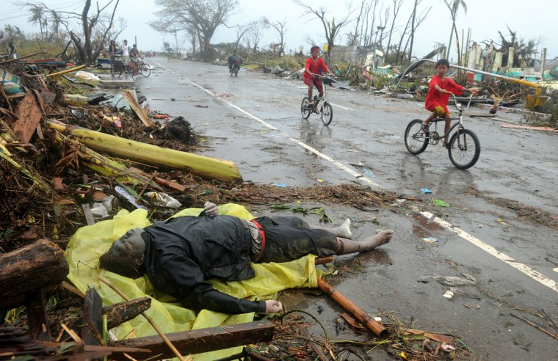

Slide 4
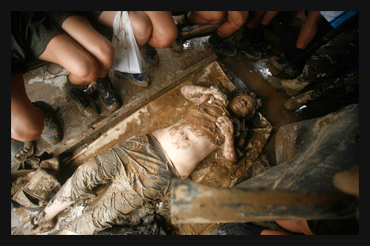

Slide 5
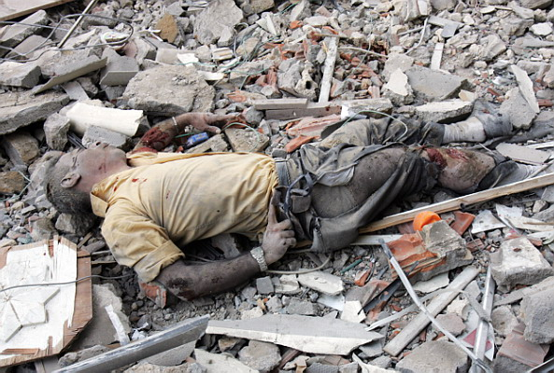

Slide 6
FORM CONTENTS FOR MISSING PERSON

Slide 7
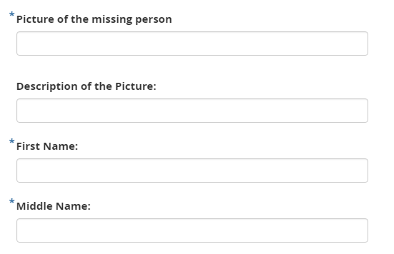

Slide 8
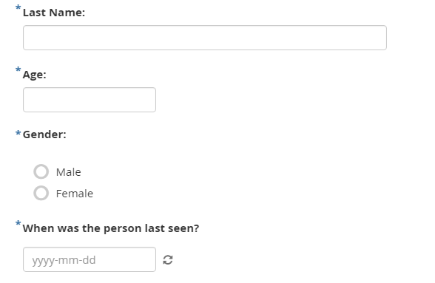

Slide 9
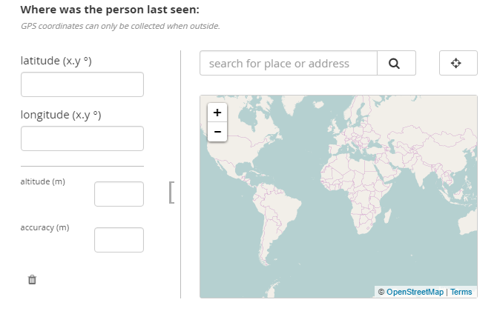

Slide 10
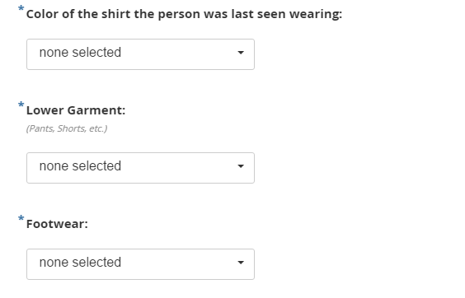

Slide 11
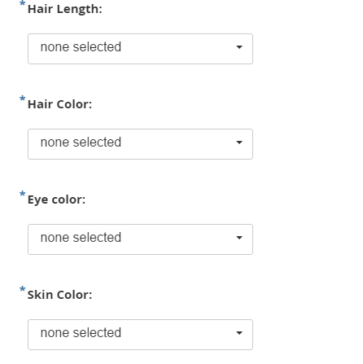

Slide 12
FORM CONTENTS FOR DEAD PERSON

Slide 13
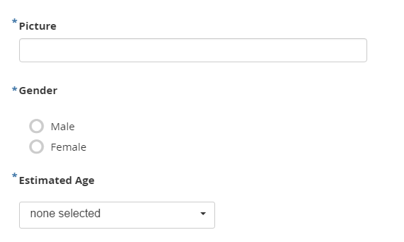

Slide 14
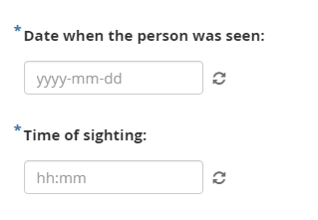

Slide 15
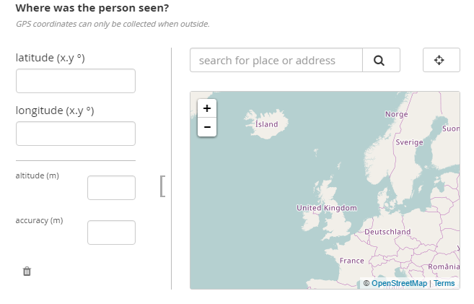

Slide 16
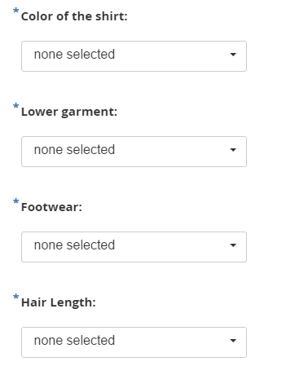

Slide 17
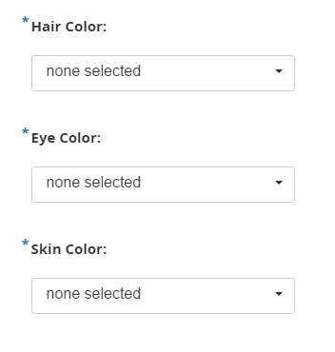

Slide 18
DASHBOARD

